Slide 1




DST-GPT
Chatting with your own Don’t Starve & Don’t Starve Together Expert!
@小孩梓Sakura
bili_sakura@zju.edu.cn

Slide 2
Outline
1. Introduction
2. Overiew of DST-GPT
3. Data Preparation
4. Framework
5. Cases
6. Future Work
References

Slide 3


1. Introduction
Tools are extensions of human capabilities, aimed at enhancing productivity, efficiency, and problem-solving abilities. The fundamental hallmark of humanity's eventual divergence from the animal kingdom is the creation and use of tools.
——Karl Heinrich Marx
Humans have always been the primary inventors and users of tools.
Can AI(Artificial Intelligence) possess the same ability to use tools as humans?

Slide 4
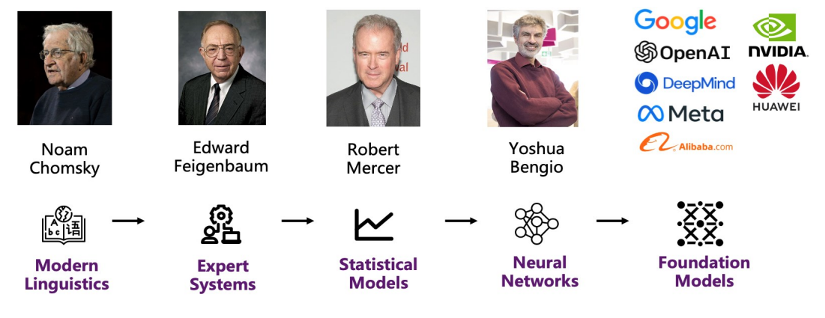
1. Introduction
Large language models(LLMs) become revolutionary tools through the following capabilities:
Rich World Knowledge
Powerful Semantic Understanding
Strong Reasoning Capabilities
Figure. Evolution of language models

Slide 5
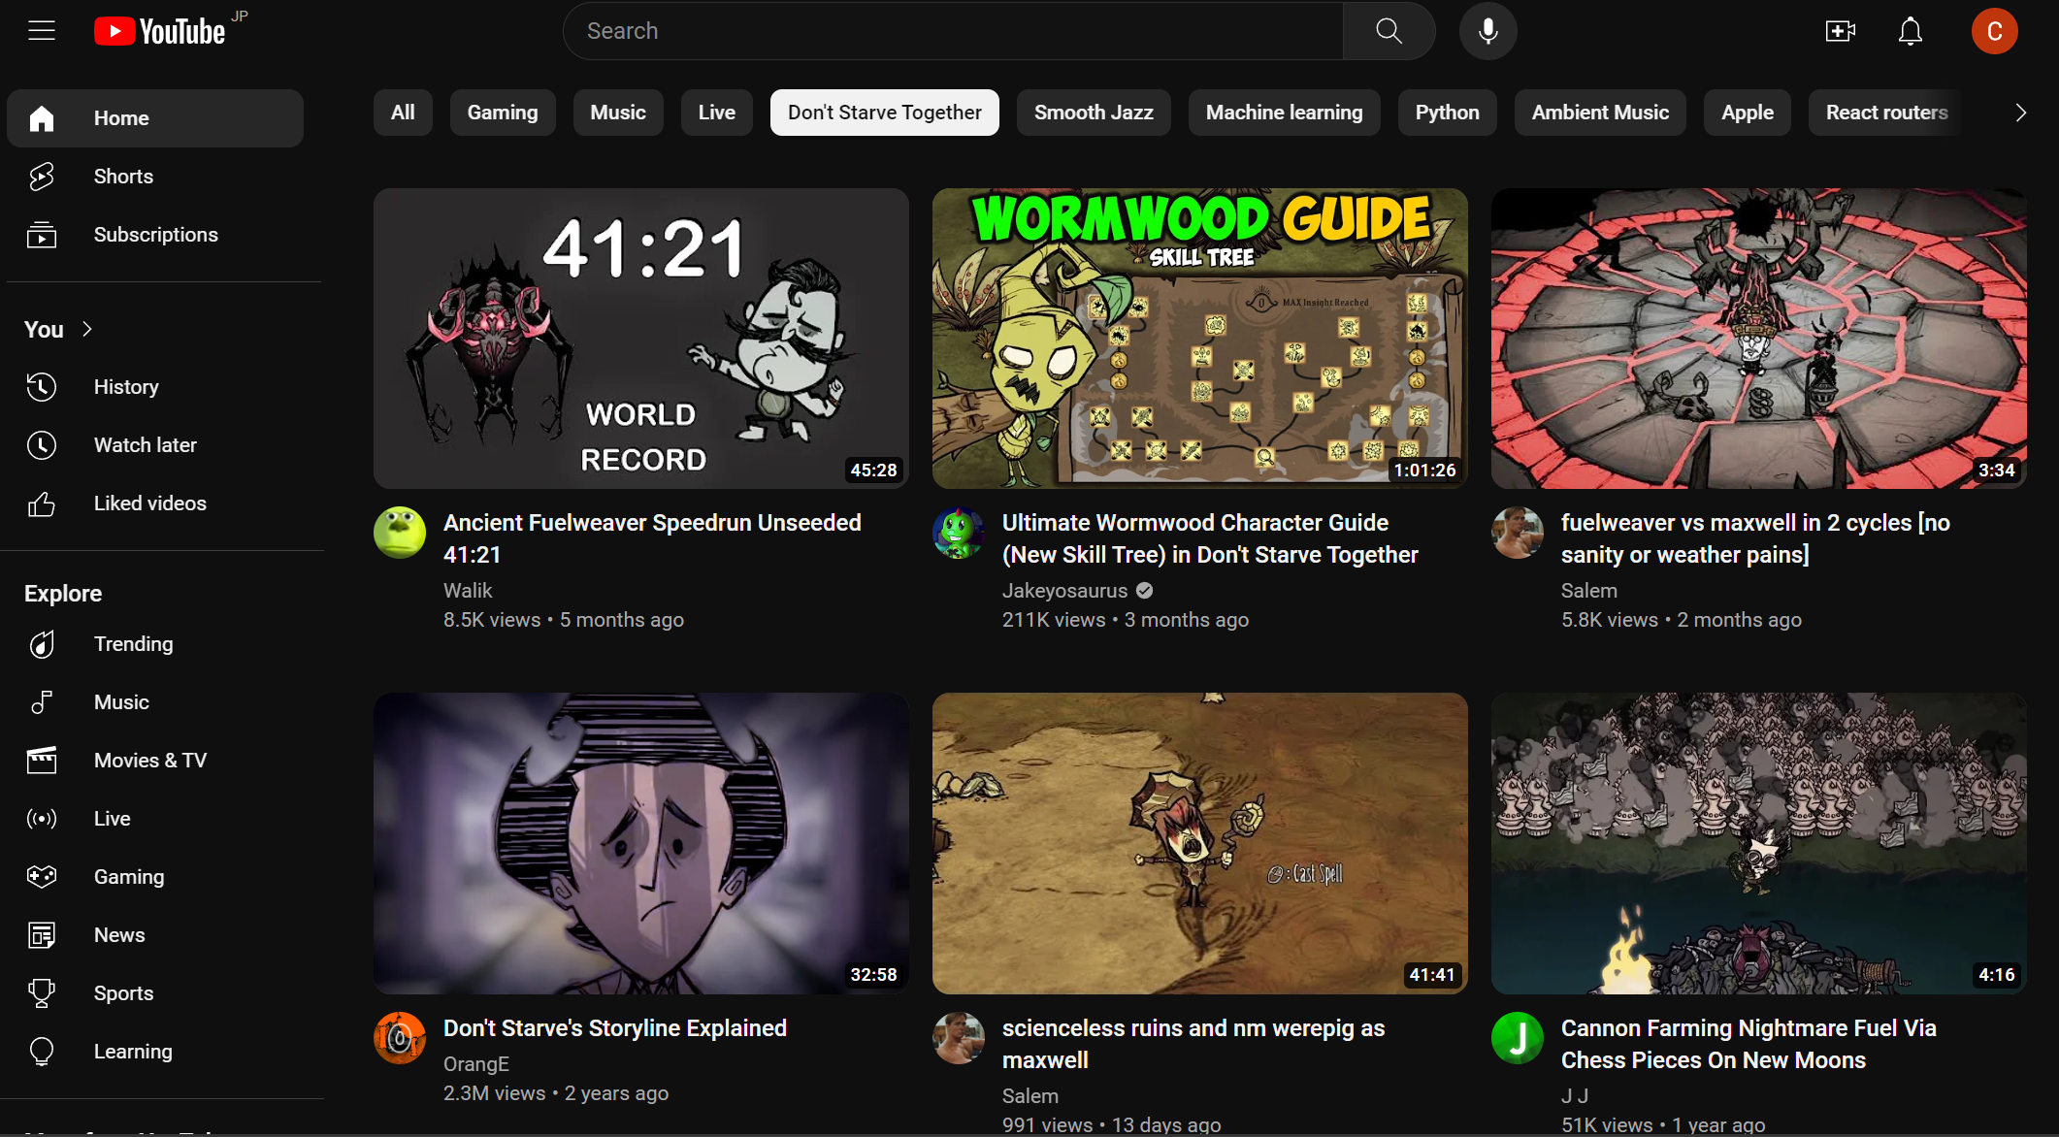



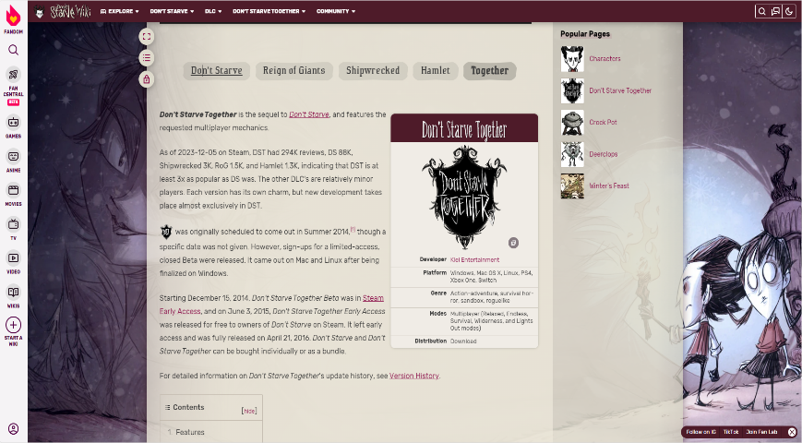
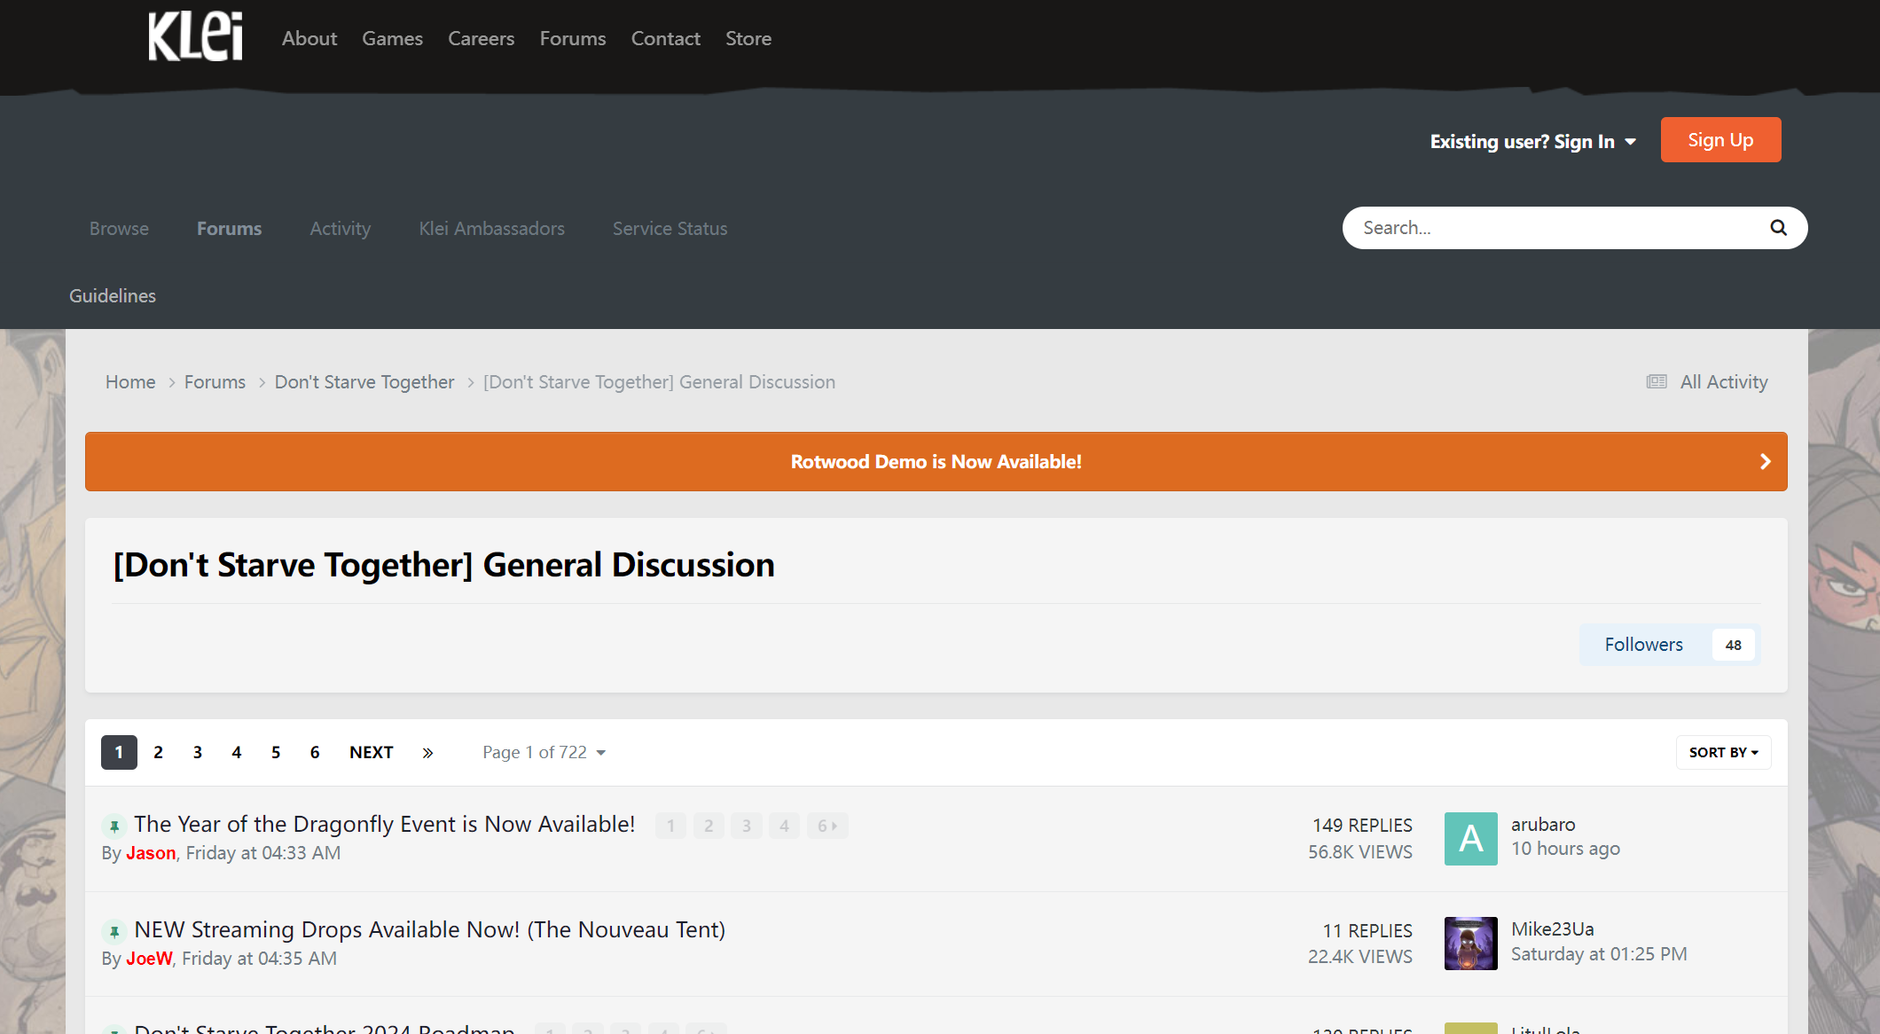

1. Introduction
For a Don’t Starve Together(DST) player, infomation queries are time-consuming and labor-intensive. It always involves of multiple direct and redirect to find final answers.
Youtube
Reddit
Wiki Fandom
Klei Forum
Figure. Pipeline of game-realted information search

Slide 6
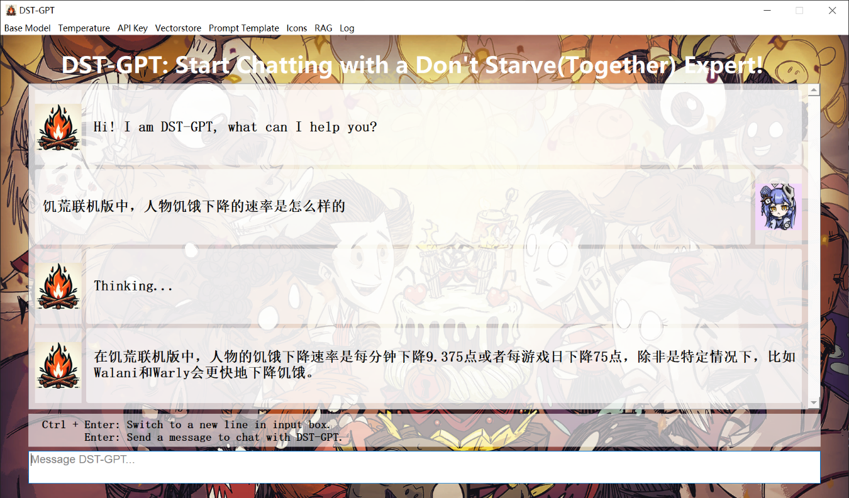
1. Introduction
Here, we introduce DST-GPT, a chatrobot based on large language models, which focuses on answering questions for both Don't Starve and Don't Starve Together.
AI chat robot always available and reliable
3A Solution
Accurate data based on solid knowledge database
Acquire a direct response to the inquiry
Figure. Chatting with DST-GPT

Slide 7
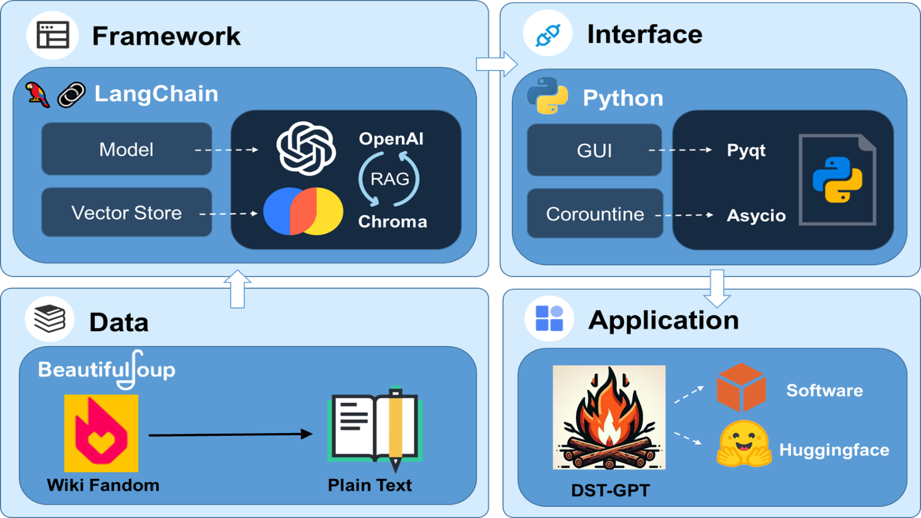
2. Overview of DST-GPT
BeautifulSoup: Webpages Crawler
LangChain: LLMs Framework
OpenAI: LLMs Core Modules
Chroma: Vectorstore
Pyqt: Graphic User Interface
Asyncio: Coroutine
Huggingface: Deployment
Figure. An overview of constructing DST-GPT

Slide 8

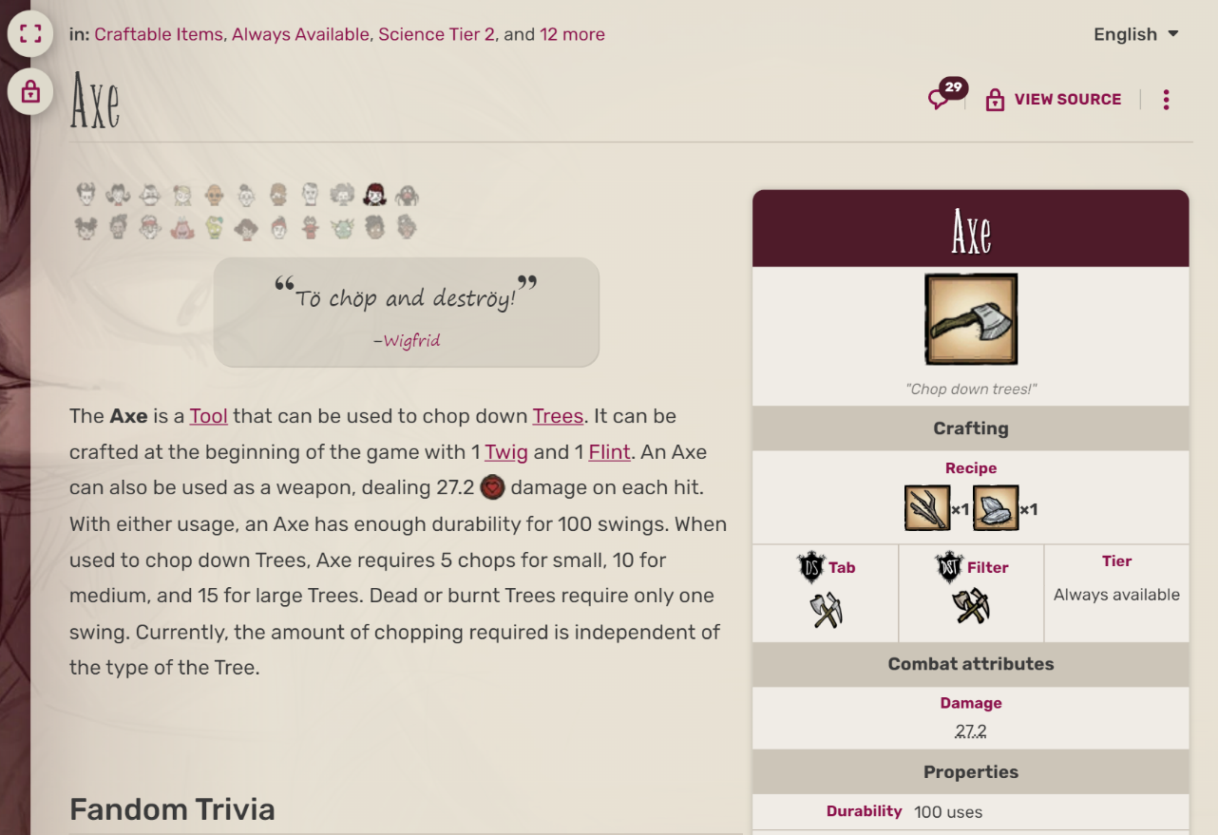



3. Data Preparation
https://dontstarve.fandom.com/wiki/Axe
https://dontstarve.fandom.com/wiki/Tree/Evergreen https://dontstarve.fandom.com/wiki/Willow/Quotes
Attributes
PC
Child URLs
text-only
~5000 pages
Plain Text
Desciptions
Courpus Source
A webpage example of item ‘axe’
Figure. Data collection in DST-GPT

Slide 9
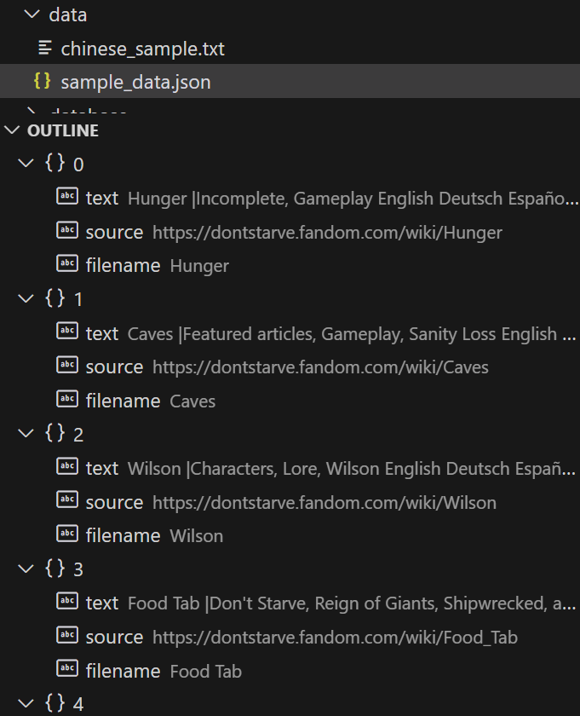
3. Data Preparation
Hunger |Incomplete, Gameplay English Deutsch Español Français Italiano 日本語 Polski Português Русский Tiếng Việt 中文 Hunger View source View history Talk (1) This article is incomplete because it needs Hamlet and DST new character info.Please help to improve the article, or discuss the issue with the community on the comment section. “I'm so hungry!” –Wilson “I need food!” –Willow “My mighty belly is empty!” –Wolfgang “I am full of emptiness.” –Wendy “FUEL RESERVES LOW” –WX-78 “Librarian needs food.” –Wickerbottom “I'm getting peckish.” –Woodie “I am empty inside.” –Maxwell “I'm so hungry my cognitive abilities are failing!” –Wagstaff “Höw I löng för a feast!” –Wigfrid “It's time for a snack!” –Webber “I'm crashing like a sick wave! Gimme food!” –Walani “I need food...” –Warly “I be hungry...” –Woodlegs “WILBA BELLY 'TIS GRUMBLY” –Wilba “Need stuff for belly” –Wormwood “When was the last time I ate?” –Wheeler “When's lunch?” –Winona “Oh no, I'm hungry again.” –Wortox “Want food!” –Wurt “Can we stop for a snack break?” –Walter “How long has it been since I last ate?” –Wanda Hunger is one of the primary game mechanics, as it's the measurement which determines whether or not the character is starving. As a character gets hungrier, this meter will empty, and the stomach pictured will shrivel. The default maximum hunger for characters is measured at 150, though many characters have different maximum hunger amounts: Wolfgang (300) (200 ) WX-78 (100-200) (150-200 ) Wes (113) (75 ) Wagstaff (225) Wigfrid (120) Webber (175) Walani (200) Warly (250) Wilbur (175) Wilba (200) Wortox (175) Wurt (200-250) Walter (110) Wanda (175) Hunger drains at 9.375 points per minute or 75 points per game day, except for: Walani , drain hunger 10% faster (10.3125 or 82.5) Warly , drain hunger 33% faster (11.25 or 99.75) Wilbur , drain hunger 33% faster (11.25 or 99.75) only when running on all fours Warly , drain hunger 20% faster (11.25 or 90) Wes (singleplayer only), drain hunger 25% faster (12.46875 or 93.75) Wormwood , drain hunger 0%, 33%, 66%, 100% faster (9.375, 11.25, 15.5625, 18.75 or 75, 99.75, 124.6, 150) Wormwood , drain hunger 0%, 6%, 13%, 20% faster (9.375, 9.9375, 10.59375, 11.25 or 75, 79.5, 84.75, 90) Wolfgang (singleplayer only), drain hunger from 0 to 200% faster (from 9.375 to 28.125 or from 75 to 225) Wilba in her Werepig form , drain hunger 400% faster (46.875 or 375) Hunger drain can also be slowed or accelerated: To 60% of base rate by equipping a Belt of Hunger To 75% of base rate by wearing the Hibearnation Vest To 80% of base rate by poisoning To 75% of base rate by equipping Funcap If a Slurper jumps onto the player it will start draining 3 points of hunger every 2 seconds and keep doing so, until it's detached from the head slot. Walter loses only half the normal hunger when Sleeping. Winona will drain 5 hunger when she speed-crafts something. Wolfgang has faster hunger drain when using the Mighty Gym. WX-78 has 20% slower hunger drain when using the Super-Gastrogain Circuit. Wilson's belly growling When the Hunger meter is emptied, Health will begin to drain at 1.25 points per second until something is eaten or the character dies. Most food will restore the Hunger meter when eaten. The amount restored depends on the food eaten; cooked food typically restores more than raw food. Some food also has the potential to decrease Hunger, Sanity, or Health. Also, when going to sleep in a Straw Roll, Fur Roll, Tent, or a Siesta Lean-to, the character takes an immediate Hunger penalty. Below is a quick reference table for how long a character can survive on a full belly before hunger goes down to 0: Character Real-life seconds Days Wurt (King of the Merms alive) 1600 3.33 Wagstaff 1440 3.0 Warly 1333 2.77 WX-78 (fully upgraded), Wilba, Wurt 1280 2.67 Wolfgang 1278 2.66 Warly 1203 2.51 Walani 1164 2.42 Webber, Wilbur, Wortox, Wanda 1120 2.33 Wilson, Willow, Wendy, Wickerbottom, Woodie, Maxwell, Woodlegs, Wheeler, Winona, Wes 960 2.0 Wormwood 960, 720, 576, 480 2.0, 1.5, 1.2, 1 Wormwood 960, 905, 849, 800 2.0, 1.89, 1.77, 1.67 Wigfrid 768 1.6 Wes 579 1.21 Wilba in her Werepig form 255 0.53 Gallery All stages of Hunger meter.Wilson starving. The Hunger meter flashes as the Health meter quickly depletes.The Hunger meter in the very early alpha of Don't Starve.A pin of the Hunger symbol from Klei's online store. Gameplay Mechanicsview Activities Cooking • Crafting • Farming • Combat • Fishing • Sleeping • Beefalo Riding ( Boating ) ( Scrapbooking ) Environment Day-Night Cycle • Moon Cycle • Nightmare Cycle • Earthquake • Lightning • Rain (Strong Winds • Fog • Waves • Flooding • Volcanic Eruption ) (Fog ) (Moonstorm • Sandstorm ) Seasons Summer • Winter • (Autumn • Spring ) (Mild Season • Hurricane Season • Monsoon Season • Dry Season ) (Temperate Season • Humid Season • Lush Season ) Mechanics Beard • Biome • Characters • Charlie • Controls • Death • Durability • Experience • Fire • Food Spoilage • Freezing • Health • Hunger • Inventory • Light • Map • Naughtiness • Non-renewable resources • Sanity • Saving • Structures (Wetness ) (Overheating ) (Poison ) (Hay Fever • Peculiar Objects • Aporkalypse • Pig Fiesta ) (Enlightenment • Events • Disease • Ghosts • World Regrowth • Skins ) Mode Survival Mode • Adventure Mode • Caves • Ruins • Volcano • World Customization Others Pig Village • Road (Trail) • Graveyard • Ocean • Abyss • Bridge • Set Piece • Things • Morgue Categories Categories: Incomplete Gameplay Languages Deutsch Español Français Italiano 日本語 Polski Português Русский Tiếng Việt 中文 Community content is available under CC-BY-SA unless otherwise noted. More Fandoms Fantasy Horror Don't Starve Advertisement Fan Feed More Don't Starve Wiki 1 Characters 2 Don't Starve Together 3 Crock Pot Explore properties Fandom Muthead Fanatical Follow Us Overview What is Fandom? About Careers Press Contact Terms of Use Privacy Policy Global Sitemap Local Sitemap Community Community Central Support Help Do Not Sell or Share My Personal Information Advertise Media Kit Contact Fandom Apps Take your favorite fandoms with you and never miss a beat. Don't Starve Wiki is a FANDOM Games Community. View Mobile Site Follow on IG TikTok Join Fan Lab
Figure. Refined corpus data in JSON file

Slide 10






4. Framework
Foundation Model
GPT-3
GPT-4
LLaMA-2
OpenAI
Meta AI
PALM-2
GLM
Google
Zhipu AI
Figure. Mainstream foundation models with AI companies

Slide 11
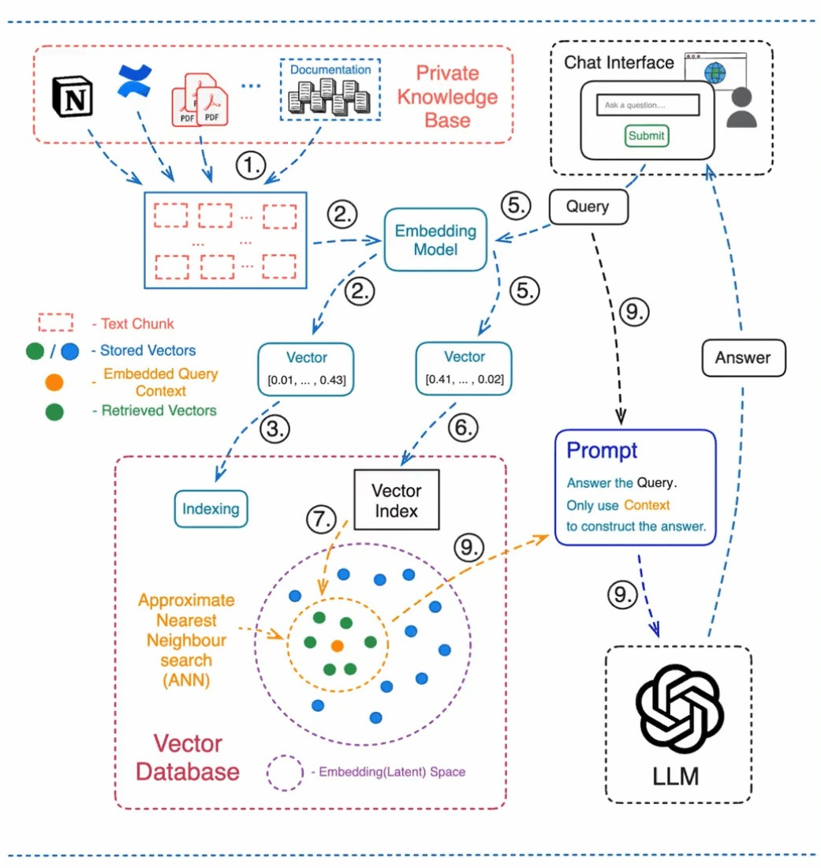
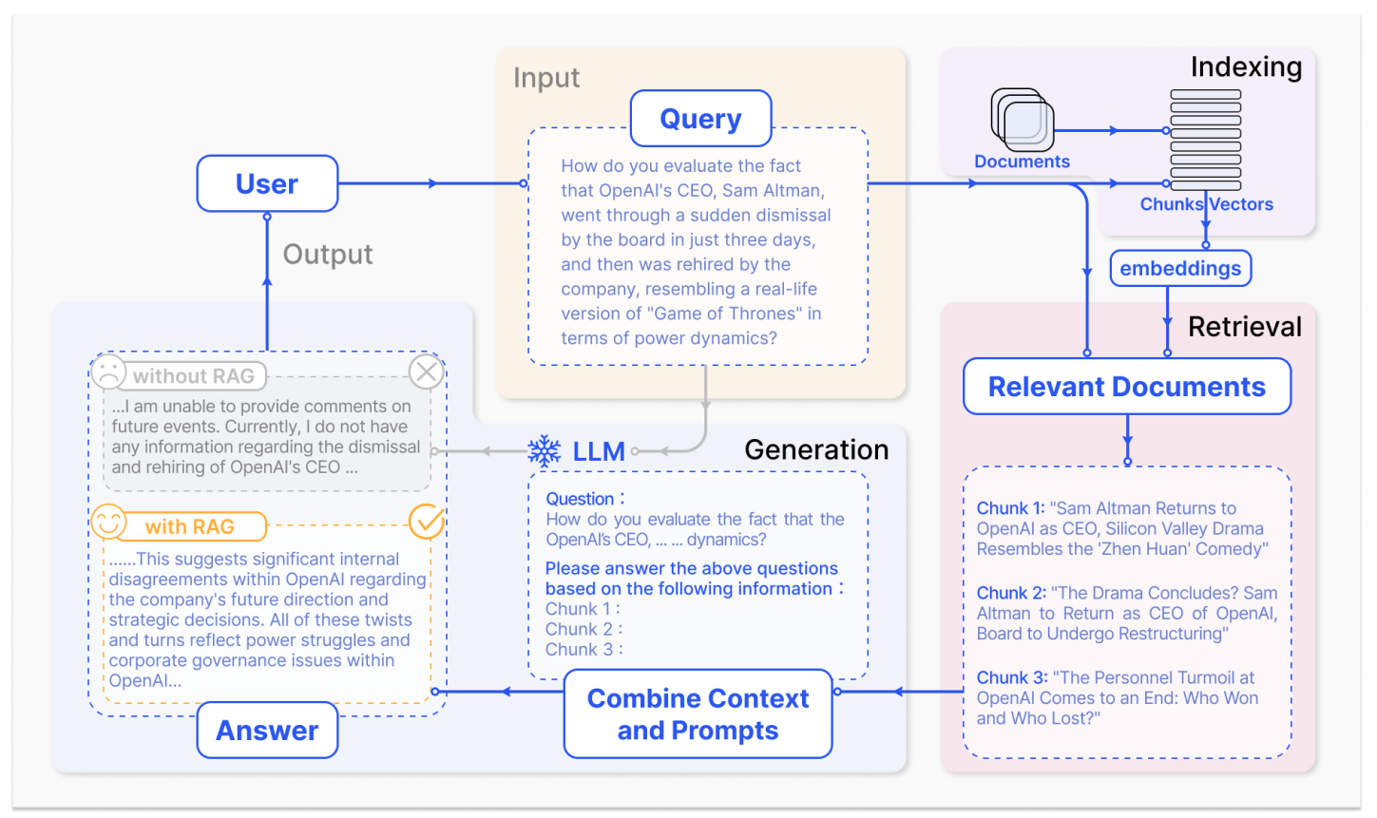
4. Framework
Retrieval Augmented Generation(RAG)
Figure. Flowchart of RAG process
Figure. A representative instance of the RAG process applied to question answering (Gao, Yunfan, et al., et al,2023)

Slide 12
4. Framework
Compared to fine-tuning, we regard RAG as a costless technique for knowledge injection to enhance the capability of LLMs with reliability and efficiency.
Feature | RAG | Fine-Tuning
Knowledge Updates | Directly updating the retrieval knowledge base ensures current information without frequent retraining, ideal for dynamic data environments. | Requires retraining for knowledge and data updates, dealing with static data.
External Knowledge | Proficient in leveraging external resources, especially for accessing documents or databases. | Can align externally acquired knowledge with large language models but less practical for frequently changing data.
Data Processing | Involves minimal data processing and handling. | Depends on high-quality datasets; limited datasets may not significantly improve performance.
Model Customization | Focuses on information retrieval and integrating external knowledge but may not fully customize model behavior or writing style. | Allows adjustments in LLM behavior, writing style, or domain knowledge based on specific tones or terms.
Interpretability | Responses can be traced back to specific data sources, offering higher interpretability and traceability. | Acts like a black box, making it unclear why the model reacts a certain way, thus lower interpretability.
Computational Resources | Requires resources for retrieval strategies and maintaining external data source integration and updates. | Necessitates resources for dataset preparation, fine-tuning objectives, and computational needs.
Latency Requirements | Data retrieval may lead to higher latency. | After fine-tuning, can respond without retrieval, resulting in lower latency.
Reducing Hallucinations | Less prone to hallucinations as answers are grounded in retrieved evidence. | Can reduce hallucinations by training on specific domain data but may still exhibit hallucinations with unfamiliar inputs.
Ethical and Privacy Issues | Concerns arise from storing and retrieving text from external databases. | Concerns may arise due to sensitive content in the training data.
Table. Comparison between RAG and Fine-Tuning (Gao, Yunfan, et al., et al,2023)

Slide 13
5. Cases

Slide 14
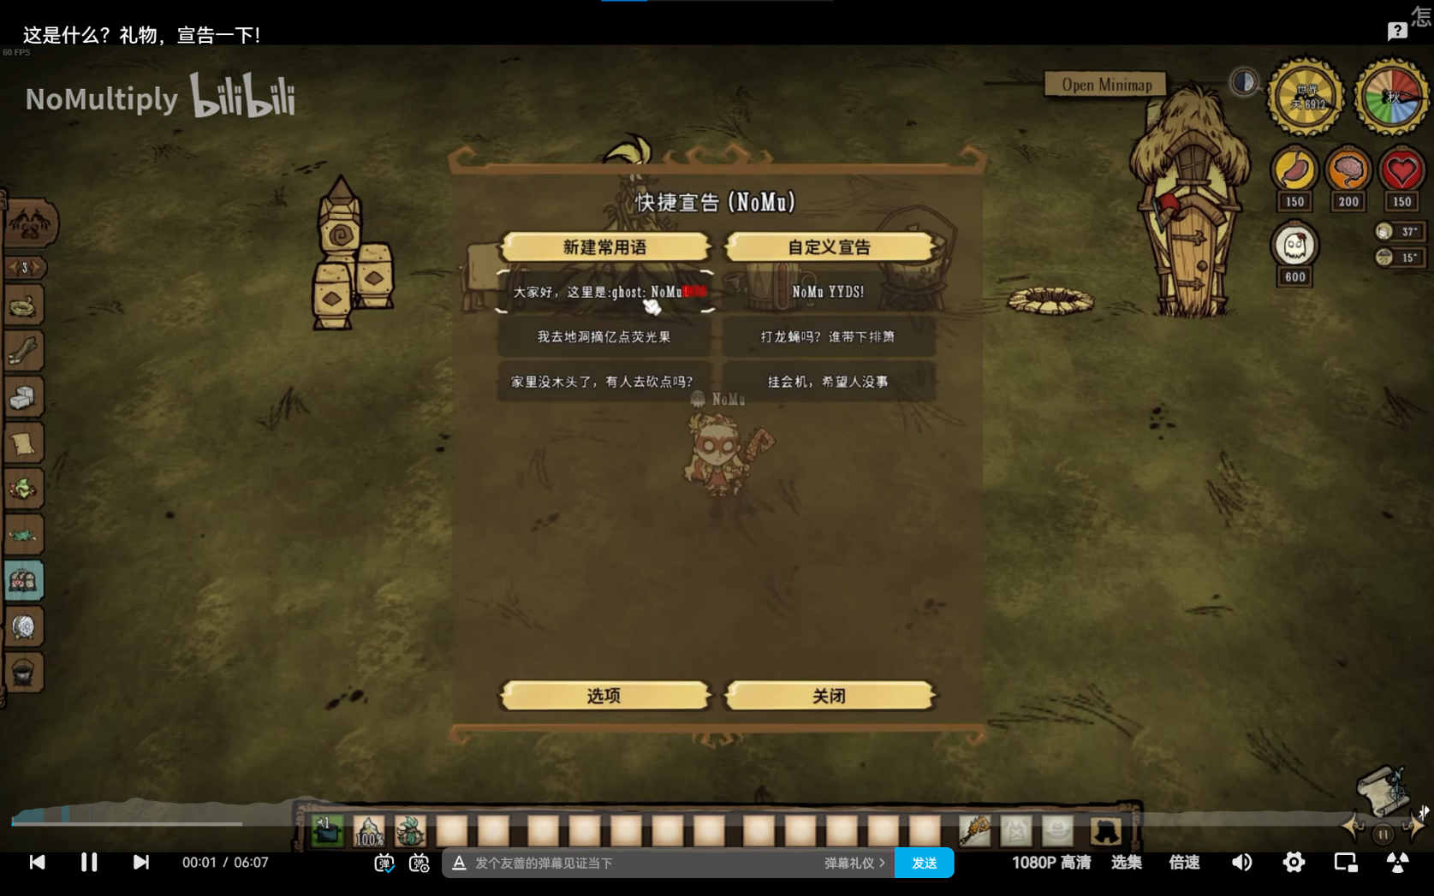

6. Future Work
In the future, we hope to provide an API for DST-GPT that can be integrated into games as a mod, allowing players to access it at any time.
Figure. A heating mod with GUI in DST( BV1pN411K7aE)

Slide 15
References
Gao, Yunfan, et al. "Retrieval-augmented generation for large language models: A survey." arXiv preprint arXiv:2312.10997 (2023).
Ovadia, Oded, et al. "Fine-tuning or retrieval? comparing knowledge injection in llms." arXiv preprint arXiv:2312.05934 (2023).
Zhao, Wayne Xin, et al. "A survey of large language models." arXiv preprint arXiv:2303.18223 (2023).

